Slide 1
Algorithmic Trading using Approximate Q- learning based Reinforcement Learning, Market Trends and Sentiment Analysis and on Grameenphone and Square Pharmaceuticals Stock Data
Group members:
Raiyaan Abdullah (AE-092-004)
Niloy Irtisam (SH-092-011)
Moniruzzaman Akash (AE-092-019)
Riad Ahmed (SH-092-040)

Slide 2
PROBLEM FORMULATION

Slide 3
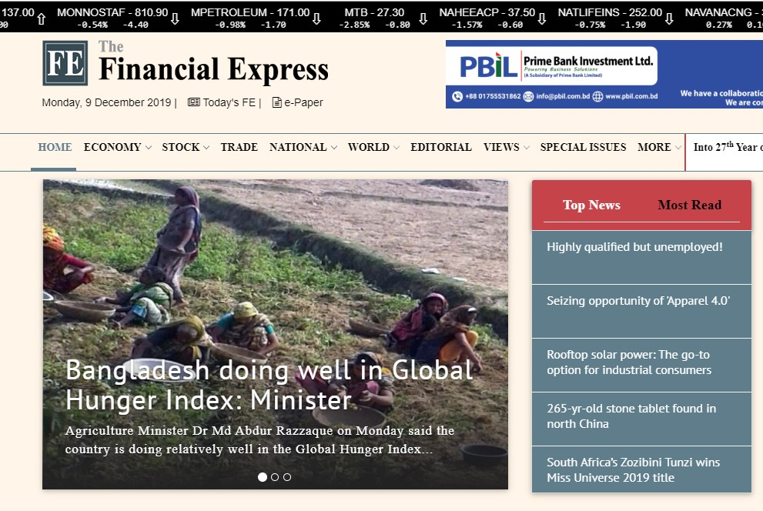
Source
Historical news of “Grameenphone” and “Square Pharmaceuticals Ltd” was obtained from the website of the Daily newspaper “The Financial Express”

Slide 4
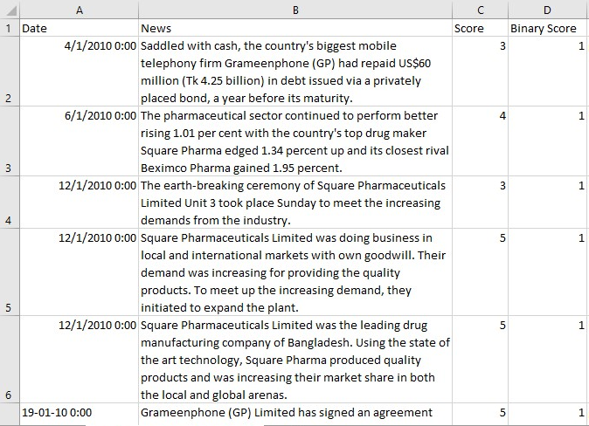
News matrix formation & Scoring
Collecting the key-line of those news an excel file was formed and scored on a scale of 0-5 where 5 means very positive news and 0 means negative for the Company. Later, a new column “Binary Score” was formed considering 3-5 as 1(positive) and 0-2 as 0(negative).
Figure: Original Dataset

Slide 5
POS Tagging
JJ: adjective or numeral, ordinal
JJR: adjective, comparative
JJS: adjective, superlative
NNS: noun, proper, singular
RB: adverb
RBR: adverb, comparative
RBS: adverb, superlative
VB: verb, base form
VBD: verb, past tense
VBG: verb, present participle or gerund
VBN: verb, past participle
VBP: verb, present tense, not 3rd person singular
VBZ: verb, present tense, 3rd person singular
Expected POS
JJ ,JJR ,JJS ,NNS ,RB ,RBR ,RBS ,VB ,VBD ,VBG ,VBN ,VBP ,VBZ ,IN

Slide 6
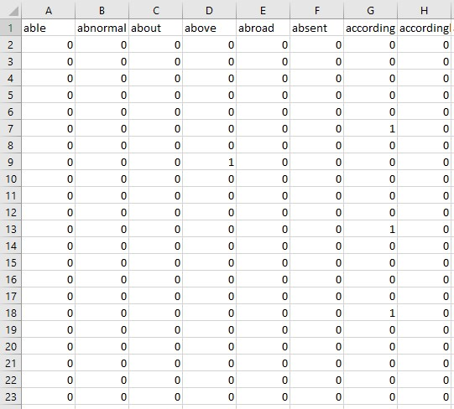
Dataset matrix formation
Columns represent all unique words
Rows represent each news
If any word exists in a news then its cell is filled with “1” otherwise “0”
Last column contains Binary sentiment score of each news
Figure: Dataset matrix

Slide 7
APPROXIMATE Q-LEARNING

Slide 8
Q Learning
Reinforcement learning involves an agent, a set of states S, and a set A of actions per state.
The goal of the agent is to maximize its total reward.
Q-learning is a model-free reinforcement learning algorithm.
When the state space becomes too large, we use Approximate Q Learning.

Slide 9
Function Approximator
 | Buy | Sell | Hold
Number of stocks | 0.99*Value | Value | 0.7*Value
Price of stocks | Value | 0.99*Value | 0.7*Value
Cash in Hand | Value | 0.55*Value | 0.3*Value
To normalize the value with other features, the cash in hand was divided by 1% of initial cash in hand.

Slide 10

Approximate Q Learning
We use function approximators.
States:
(# of Stocks for each asset), (Current Stock Price for each asset), Cash in Hand
Actions:
BUY, SELL and HOLD
Features:
(# of Stocks for each asset), (Current Stock Price for each asset), Cash in Hand
f(s,a) returns a value with respect to state and action

Slide 11

Training
Initial state:
(0,0,GP closing price of day 15, Square closing price of day 15, 100000tk)
Updating weights
Exploration probability = 1x10⁻⁹
Reward: [Current Value of the Portfolio - Initial Investment]
Number of iterations 15 (90% Random, 10% Optimal)

Slide 12
TREND ANALYSIS

Slide 13
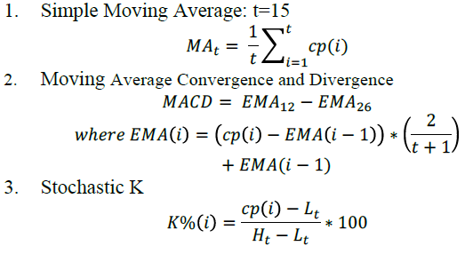
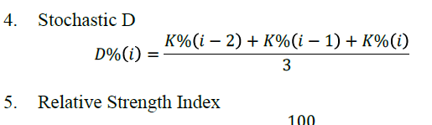

Market Indicators:

Slide 14
Dataset formation:
Inputs: 5 market indicators
Output: Short term Market trend (1 – upward trend, 0 – downward trend)
Trend:
Closing price change over a day
Closing price change over the last 15 days
Closing price change over the last 5 days and next 5 days

Slide 15
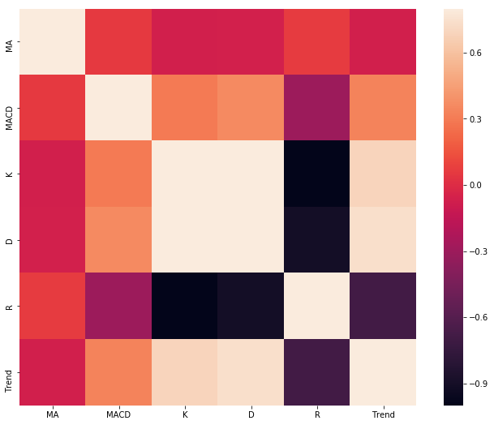
Correlation Heatmap

Slide 16
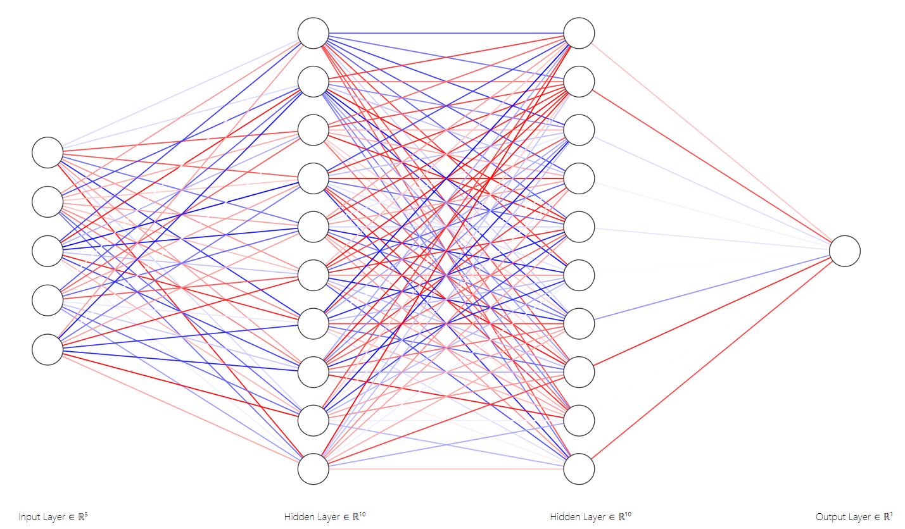
Neural Network Structure

Slide 17
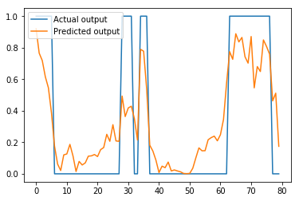
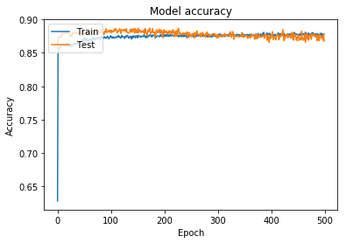
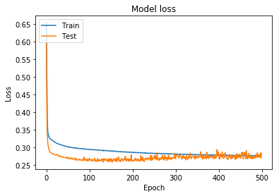
Results

Slide 18
Augmentation into MDP
Added market trend (1 or 0) as 4th feature f4 of the MDP
Q – learning was performed to determine 4 weights
No significant improvement

Slide 19
SENTIMENT ANALYSIS

Slide 20
Sentiment Analysis
Process:
1. Collect news from Financial express
2. Manual Scoring
3. Interpolate score
4. Split dataset into Grameenphone and Square Comp. Ltd.
5. Feed the dataset into Q-learning algorithm as a new feature.

Slide 21
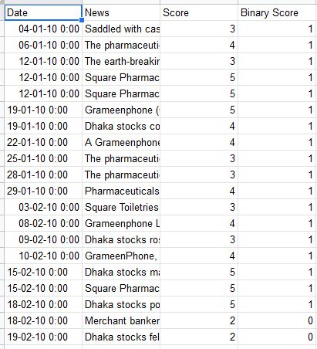
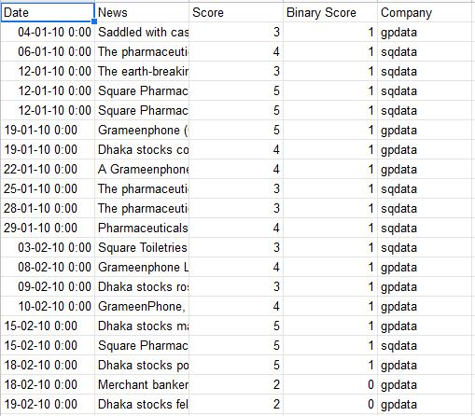
Original Dataset
Dataset after Classification

Slide 22
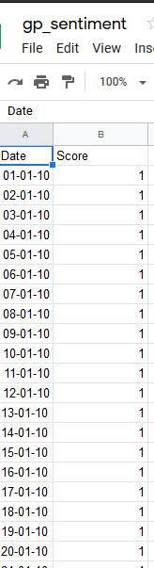
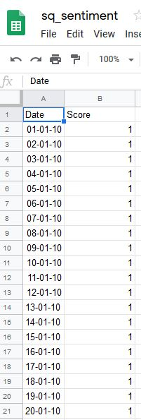
Fig: Grameenphone and Square interpolated Dataset

Slide 23
THANK you

